Slide 1
Air Quality Dataset
By
Kaushik B

Slide 2
Before The Analysis
Understanding the data
  The data we have is about the air quality of Indian states released by the Ministry of Environment and Forests and Central Pollution
  Data we have has 134116 rows and 12 different columns
  We have a data of Indian states’ air quality over 4 years

Slide 3
  Understanding Important Columns
state: It represents the states whose air quality data is measured.
location: It represents the city whose air quality data is measured.
type: The type of area where the measurement was made.
so2: The amount of Sulphur Dioxide measured.
no2: The amount of Nitrogen Dioxide measured
rspm: Respirable Suspended Particulate Matter measured.
spm: Suspended Particulate Matter measured.
location_monitoring_station: It indicates the location of the monitoring area.
date: It represents the date of recording

Slide 4
Before The Analysis
Dropping the columns which don’t help with the study or are full of null values:
  PM2-5,
  Stn_code
Fixing the null values of data:
  We used median values state wise to replace the null values

Slide 5
Analysis and data wrangling

Slide 6
Basic Data analysis
What are the levels for the state wise data ?

Slide 7
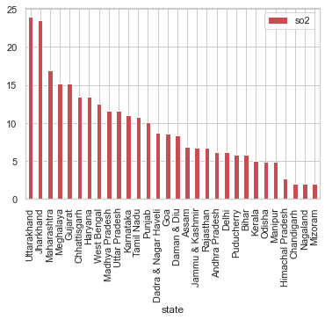
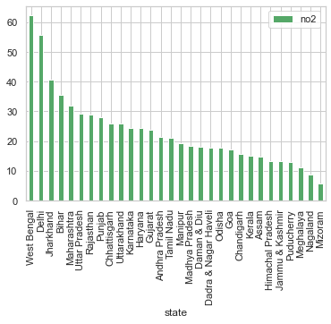
SO2 & NO2 average levels of states over 4 years

Slide 8
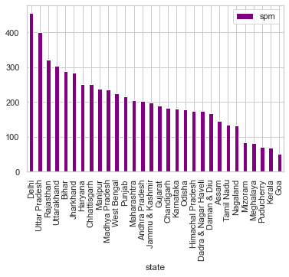
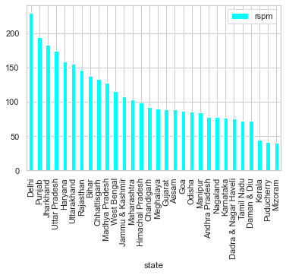
RSPM & SPM average levels of states over 4 years

Slide 9
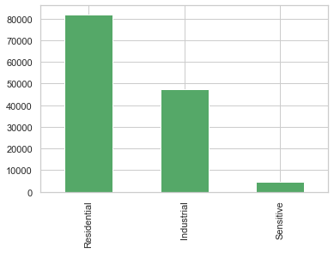
Different type of areas in data

Slide 10
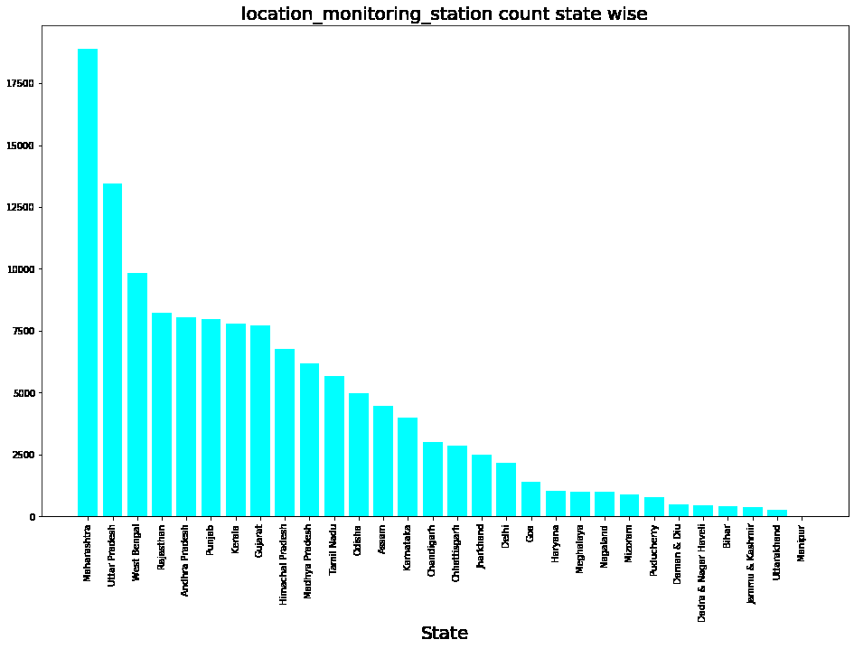
No. of monitoring stations state wise

Slide 11
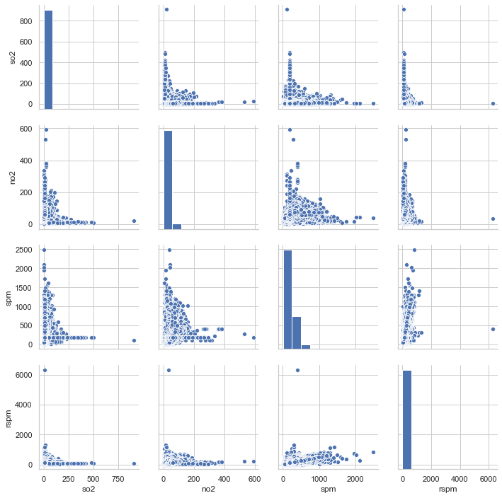
Pair Plots - Pollutants

Slide 12
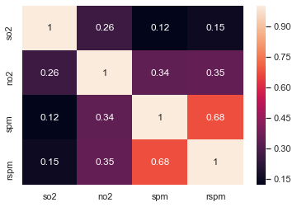
Correlation heat map between the pollutants

Slide 13
Data analysis on basis of time
Is there is a Massive difference between the levels over the period of four years ?

Slide 14
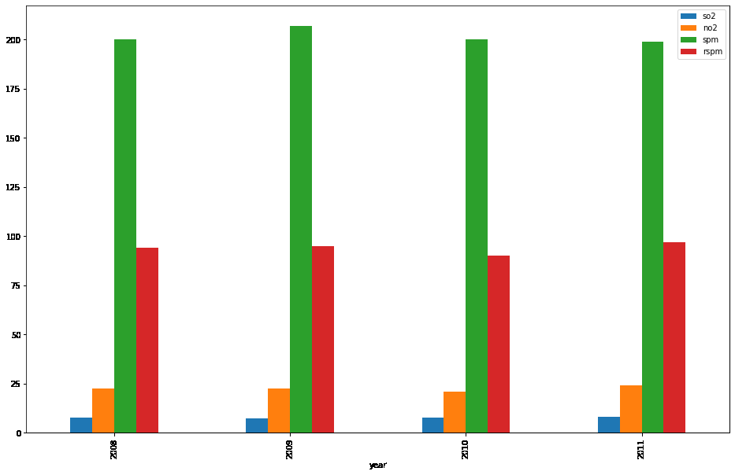
India’s Average Pollutants Level over the years

Slide 15
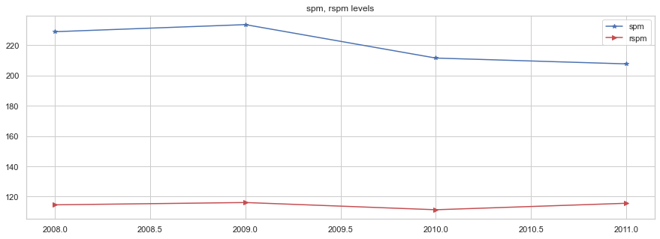
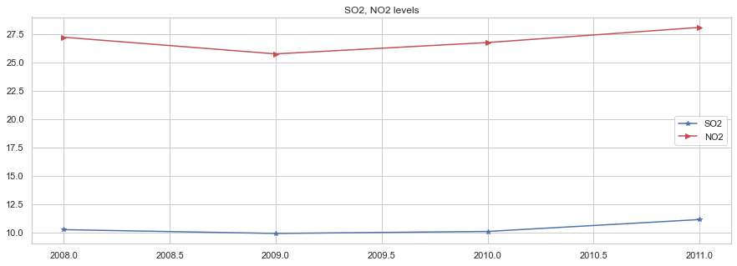
Increase in pollutants Over these four years

Slide 16
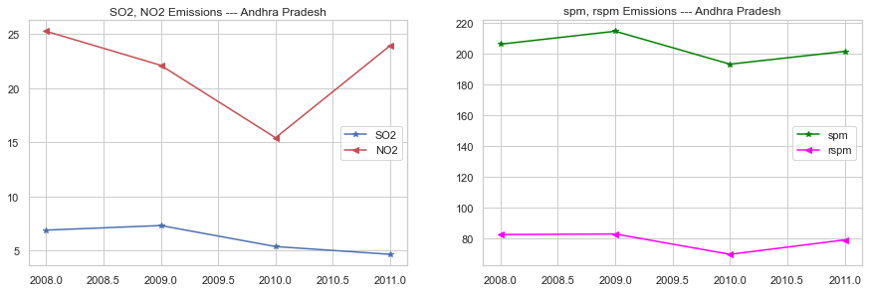
State wise increase Over these four years

Slide 17
Data Analysis Of India By Dividing It Four Zones
Which amongst the four zone’s is the most polluted ?

Slide 18
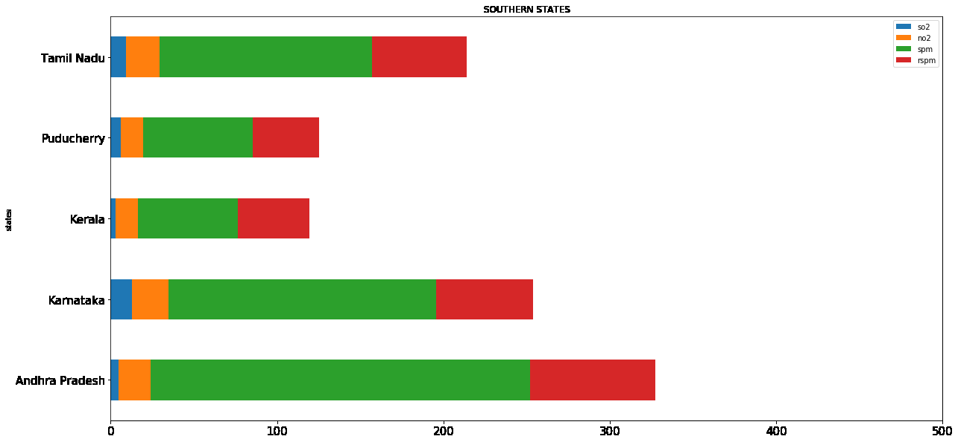
Levels chart of states in south zone

Slide 19
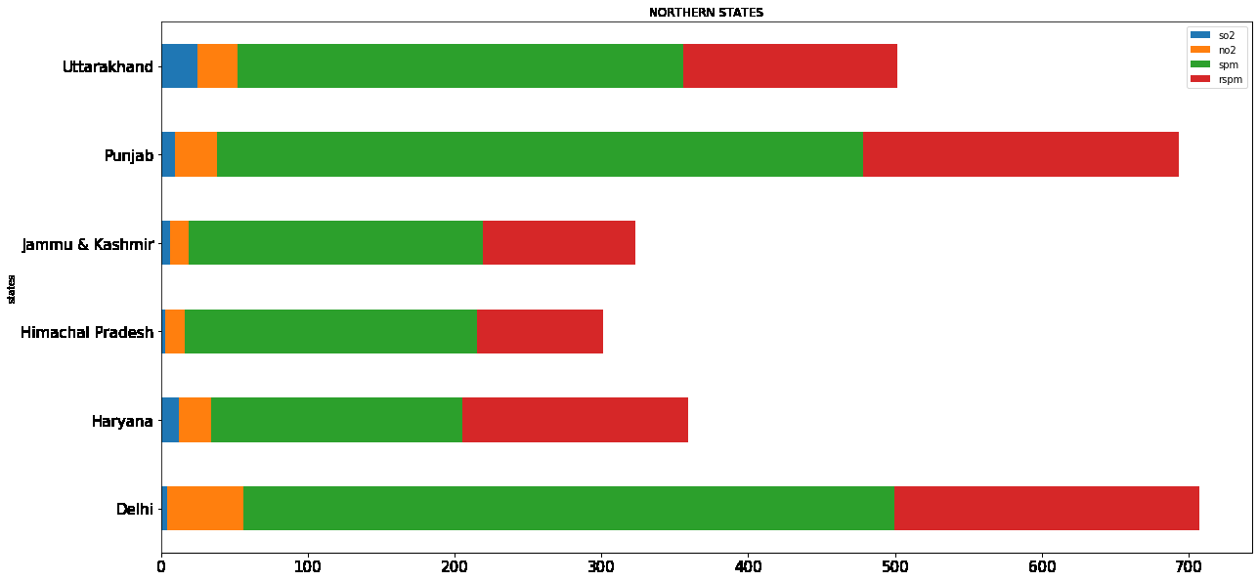
Levels chart of states in North zone

Slide 20
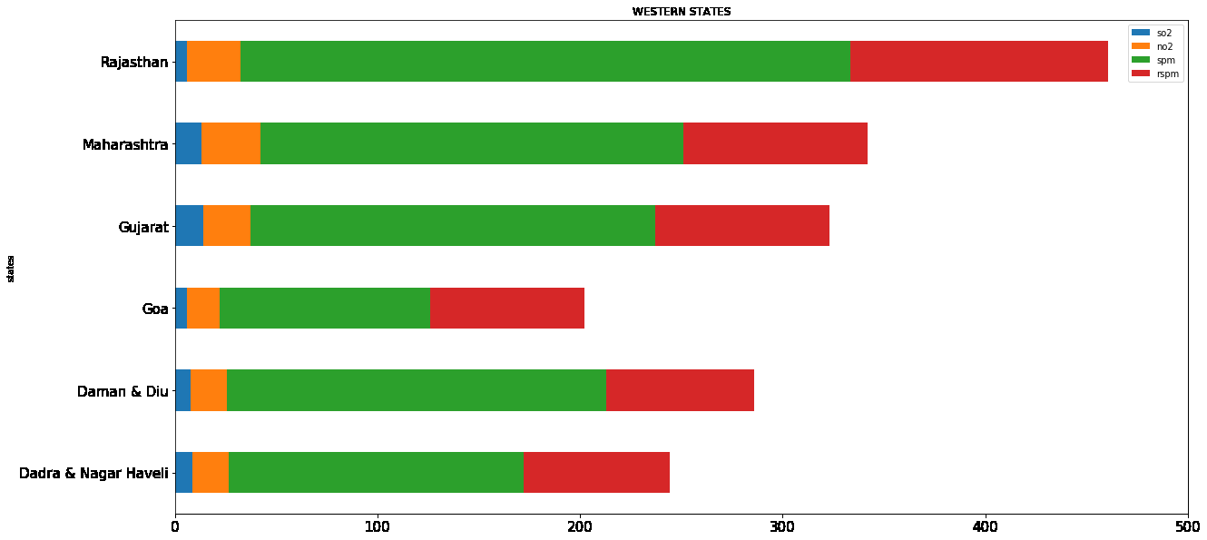
Levels chart of states in west zone

Slide 21
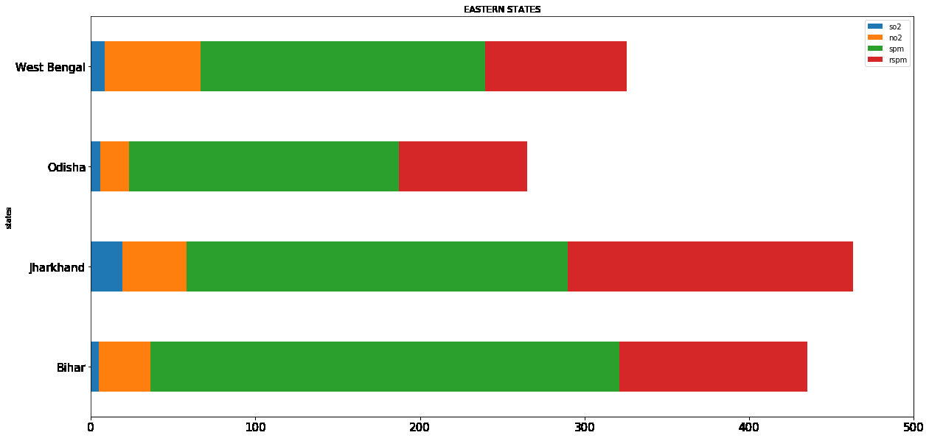
Levels chart of states in east zone

Slide 22
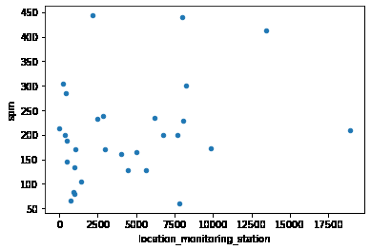
There is no correlation between monitoring stations and the Suspended Particulate Matter

Slide 23
Data analysis of India by dividing it in 3 parts based on type
Industrial
Residential
Sensitive
Which type and in which has the maximum level of SO2, NO2, SPM, RSPM

Slide 24
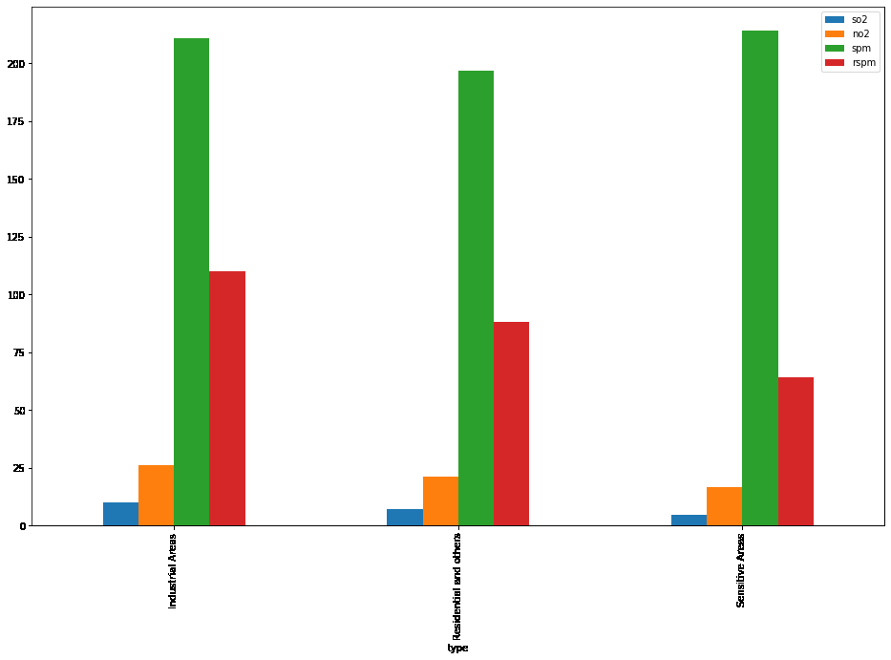
Average Level Over 4 Years Of Different Type Of Location

Slide 25
Zone Wise Count of Area Types
TYPE | COUNT (South)
Residential and others | 14449
Industrial Areas | 10010
Sensitive Areas | 1796
TYPE | COUNT (North)
Residential and others | 9889
Industrial Areas | 8141
Sensitive Areas | 542
TYPE | COUNT (East)
Residential and others | 8870
Industrial Areas | 8874
Sensitive Areas | NA
TYPE | COUNT (West)
Residential and others | 23690
Industrial Areas | 13095
Sensitive Areas | 400

Slide 26
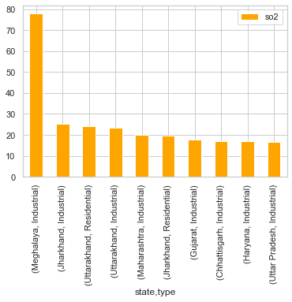
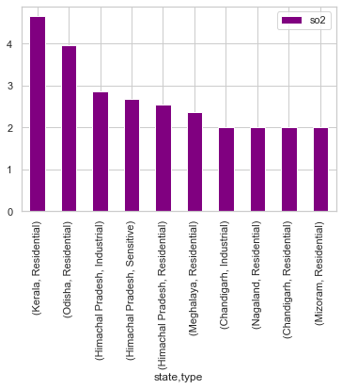
Comparison between type of areas having highest & lowest level of SO2

Slide 27
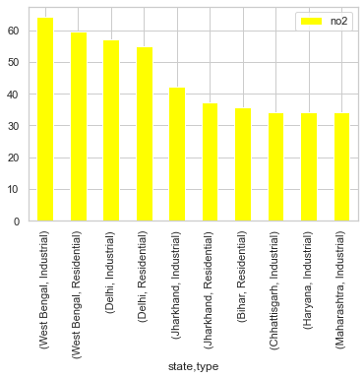
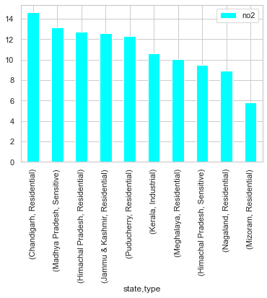
Comparison between type of areas having highest & lowest level of NO2

Slide 28
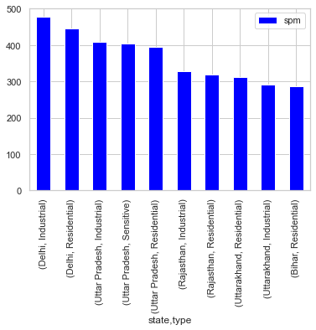
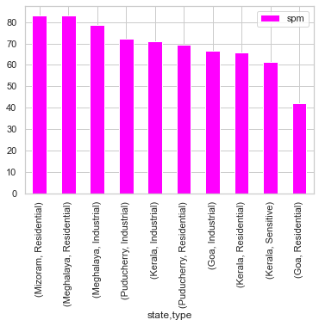
Comparison between type of areas having highest & lowest level of SPM

Slide 29
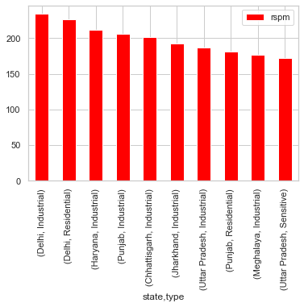
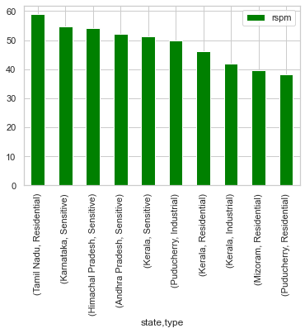
Comparison between type of areas having highest & lowest level of RSPM

Slide 30
Which location in each state is the most polluted ?

Slide 31
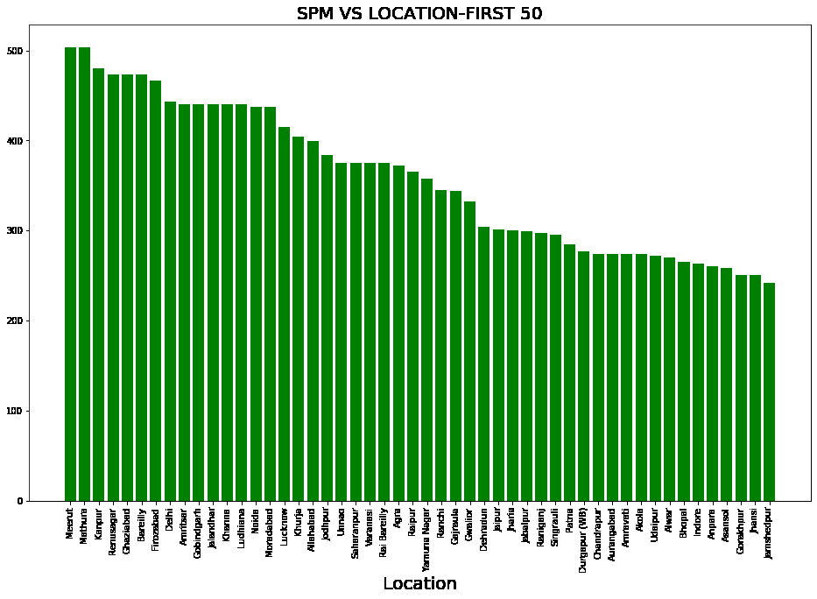
Location wise highest level of SPM

Slide 32
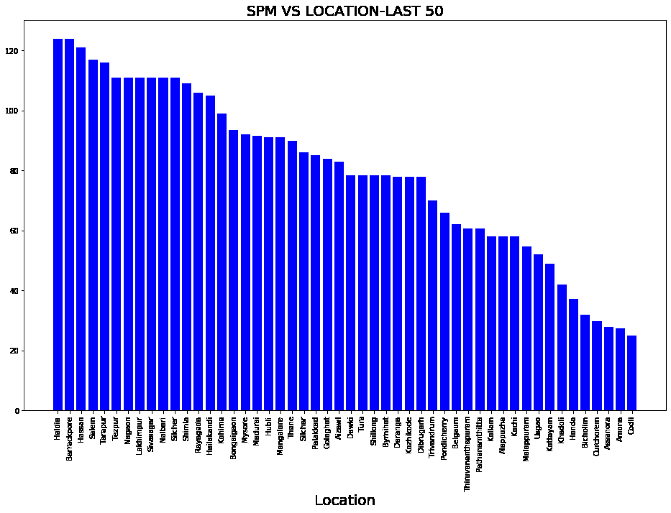
Location wise highest lowest of SPM

